Slide 1
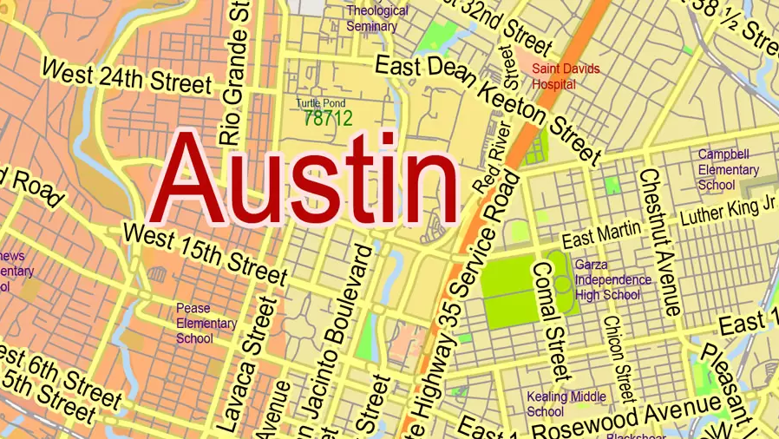
What Factors Most Impact Austin Housing Value?
08/02/23
Group 1: Latricee, Rodneaa, Angelo, Christina and Marshal
Notes:
What Factors Most Impact Housing Value?

Slide 2
was the average house value per zip code annually
Introduction
The primary objective of this presentation is to analyze and understand how education, income, and ethnicity impact the average housing values in five specific zip codes within the Austin City Limits. By examining these variables, we aim to gain valuable insights into the dynamics of the real estate market in these areas.
Notes:
Consider talking about:
Median Multiple
Housing Affordability Index (HAI)

Slide 3
Hypothesis
Our analysis will reveal that the variables of Education, Income, and Ethnicity have a significant impact on housing prices in the 5 selected zip codes within the Austin city limits?!

Slide 4

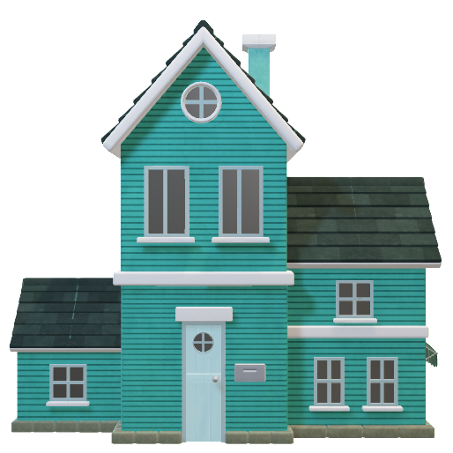
Methodology?
Zillow -
Zillow Home Value Index (ZHVI) A measure of the typical home value and market changes across a given region and housing type. https://www.zillow.com/research/data/
Housing Data
API
Rapid API to get the Zipcode Data
zip-code-master.p.rapidapi.com
Open Source
Scout Neighborhood – Crime Data for zipcodes https://www.neighborhoodscout.com/tx/austin/demographics

Slide 5

Overview of Five Zip-Codes:
78744
78729
78741
78724
78733

Slide 6
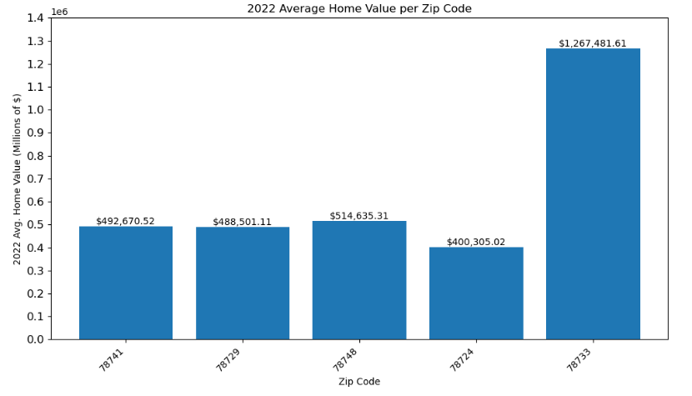
Average Home Values per Zip Code for 2022
Zip code 78733 average house value is about 3 times the value of 78724 and twice the values of the other 3 zip codes.
Notes:
Consider talking about:
Supply and demand
Some of the factors that affect the supply and demand of housing stock
Factors that affect tenure choices (ex. owner occupier, private rented, social rented)

Slide 7
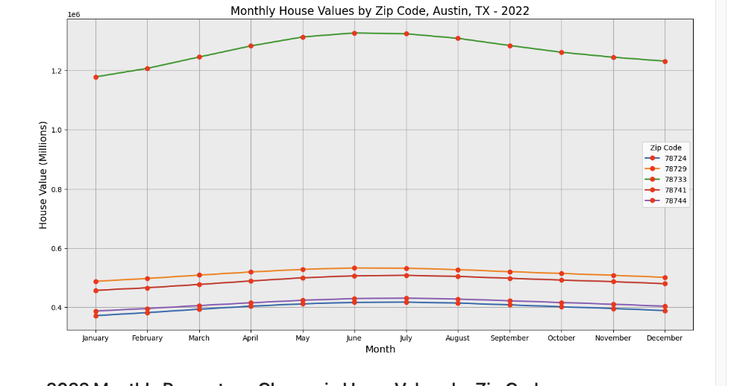
Monthly Home Values
This figure represents the percent change in values from Jan to Dec of 2022. It advises that in each zip code had an increase in home values that year. Interestingly, though 78729 has a higher median income than other zips (78724 and 78741), they had the least amount of change in property value this year
Notes:
Consider talking about:
Supply and demand
Some of the factors that affect the supply and demand of housing stock
Factors that affect tenure choices (ex. owner occupier, private rented, social rented)

Slide 8
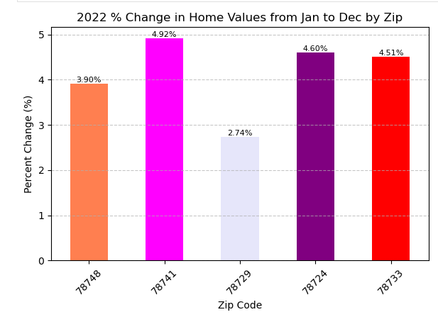
2022 % Change in Home Values
This figure represents the percent change in values from Jan to Dec of 2022.
It advises that in each zip code had an increase in home values that year. Interestingly, though 78729 has a higher median income than other zips (78724 and 78741), they had the least amount of change in property value this year.
Notes:
Consider talking about:
Supply and demand
Some of the factors that affect the supply and demand of housing stock
Factors that affect tenure choices (ex. owner occupier, private rented, social rented)

Slide 9
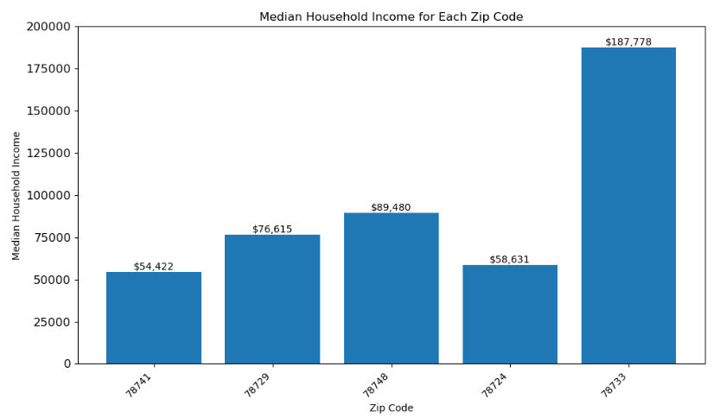
Median Household Income per Zip Code
Zip code 78733's average household income is almost 3 times that of the zip code with the lowest average household income.
Notes:
Consider talking about:
Supply and demand
Some of the factors that affect the supply and demand of housing stock
Factors that affect tenure choices (ex. owner occupier, private rented, social rented)

Slide 10
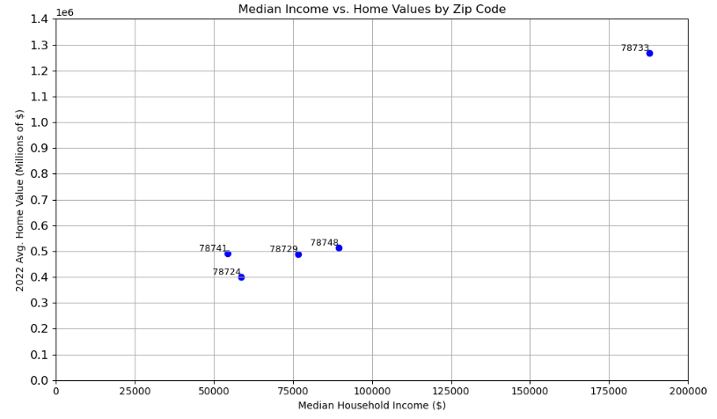
Median Income and Home Values
There is a positive correlation between median household income and average housing value.
Zip codes with higher median household incomes tend to have higher average housing values, indicating that income level is a significant determinant of housing prices.
Notes:
Consider talking about:
Supply and demand
Some of the factors that affect the supply and demand of housing stock
Factors that affect tenure choices (ex. owner occupier, private rented, social rented)

Slide 11
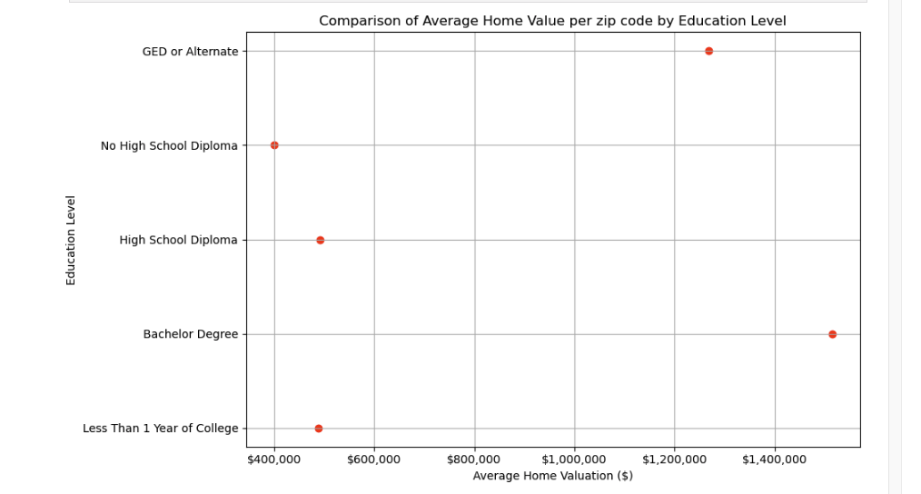
Average Home Value & Education Comparison
We can see the majority of homes for the 5 zip codes we analyzed are around 400k or higher. The two far-west zip codes we used are drastically higher and close to 1.2 -1.5 million. These homes are out by Lake Austin.
Notes:
Consider talking about:
Supply and demand
Some of the factors that affect the supply and demand of housing stock
Factors that affect tenure choices (ex. owner occupier, private rented, social rented)

Slide 12
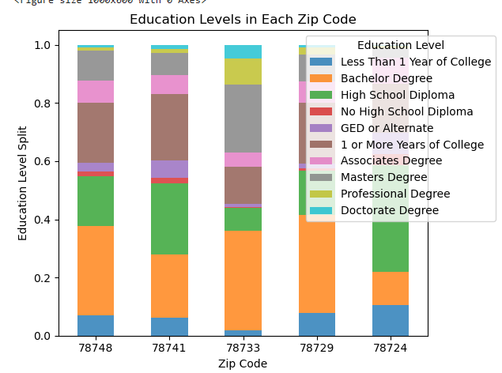
Education Per Zipcode
From this data, we can see that the majority of homeowners here have a bachelor's degree. Except for 78725 where the majority of homeowners only have a high school diploma. I find this interesting and wonder why there is a disparity there.
Education distribution shows a significant percentage of residents with bachelor's degrees (34.31%).
Notes:
Consider talking about:
Supply and demand
Some of the factors that affect the supply and demand of housing stock
Factors that affect tenure choices (ex. owner occupier, private rented, social rented)

Slide 13
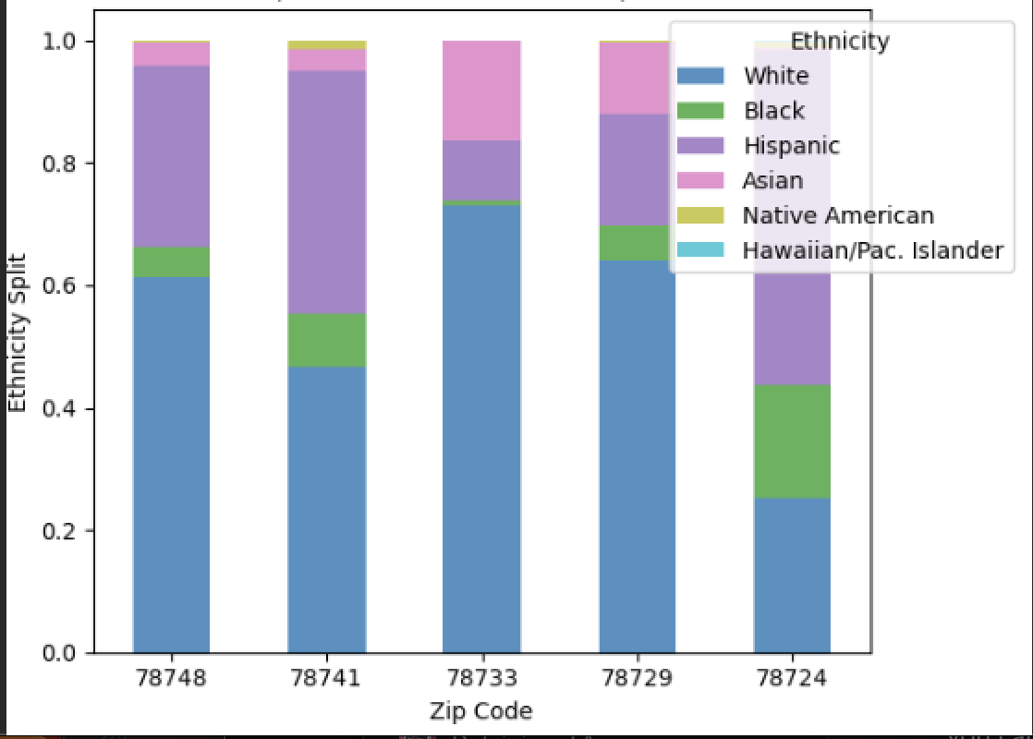
Ethnic Groups
Zip code 78733, White ethnicity dominates with a percentage of approximately 72.92%, while in zip code 78744, Hispanic ethnicity has the highest representation at 39.61%.
The Native American ethnicity has the lowest representation in all zip codes.
Racial Segregation: The data indicates that there might be some level of racial segregation in certain zip codes. For instance, zip code 78724 has a relatively lower representation of White ethnicity (25.12%) compared to other zip codes, while zip code 78733 has a much higher representation (72.92%). This suggests that certain ethnic groups might be more concentrated in specific areas.
Notes:
Consider talking about:
Supply and demand
Some of the factors that affect the supply and demand of housing stock
Factors that affect tenure choices (ex. owner occupier, private rented, social rented)

Slide 14
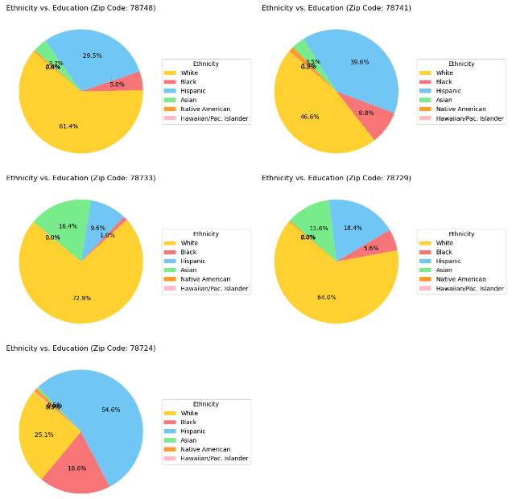
Ethnicity & Education Comparison
The data reveals significant disparities in educational attainment among different ethnic groups.
64.04% of White individuals have at least a year of college education, while only 22.73% of Black individuals and 20.93% of Hispanic individuals have achieved the same level of education.
30.66% of White individuals have a Master's degree, the percentages for Black (7.64%) and Hispanic (9.33%) individuals are substantially lower. These disparities highlight the need for targeted educational initiatives to address and reduce the education gap between ethnicities in the area which can also impact income and housing value/purchasing.
Notes:
Consider talking about:
Supply and demand
Some of the factors that affect the supply and demand of housing stock
Factors that affect tenure choices (ex. owner occupier, private rented, social rented)

Slide 15
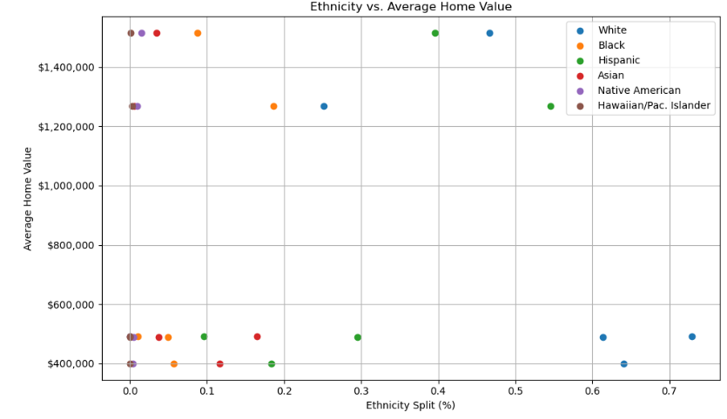
Ethnicity & Average Home Value
Ethnicity and Housing Value Disparities: Housing values differ based on ethnicity distribution in the zip codes. Areas with a higher percentage of White residents tend to have higher average housing values, while those with larger Black and Hispanic populations have relatively lower average housing values, highlighting potential disparities in housing affordability.
Notes:
Consider talking about:
Supply and demand
Some of the factors that affect the supply and demand of housing stock
Factors that affect tenure choices (ex. owner occupier, private rented, social rented)

Slide 16
Conclusion
The data analysis highlights the complex interplay of demographic factors, income, education, and ethnicity in shaping the housing market in different zip codes in Austin, TX. The conclusions can serve as a starting point for policymakers and stakeholders to develop targeted housing and urban development strategies that promote inclusivity, affordability, and sustainable growth in the city.

